Slide 1
Create Single Page Application

Slide 2
Objectives
Single Page Application (SPA)
Advantages and disadvantages of SPA
SPA Architecture
Popular framework for SPAs
Implementation SPA with ReactJS and Spring Boot

Slide 3
What is a Single Page Application (SPA)?
A web application that loads a single HTML page and dynamically updates content as the user interacts with the app.
No full page reloads, providing a seamless and fluid user experience.
SPA characteristics
Dynamic content updates
Client-side rendering
JavaScript-heavy
Relies on APIs for data communication

Slide 4
Advantages of SPAs - 1
Fast and responsive
Content updates are quick and seamless, no waiting for page reloads.
Feels more like a native app experience.
Improved user experience
Smooth transitions and interactions create a more engaging experience.
Reduced interruptions enhance user flow.
Efficient bandwidth usage
Only necessary data is transmitted, reducing server load and bandwidth consumption.
Faster loading times, especially on subsequent interactions.

Slide 5
Advantages of SPAs
Caching capabilities
SPAs can cache data effectively, enabling offline functionality and faster loading.
Improved performance and resilience.
Development efficiency
Clear separation of concerns between frontend and backend.
Easier to develop, test, and maintain.

Slide 6
Disadvantages of SPAs - 1
Initial load time
Can be longer due to the initial download of all necessary JavaScript and assets.
Impacts first impressions and user perception.
SEO challenges
Search engines may have difficulty indexing dynamic content.
Requires careful implementation of SEO strategies
Security concerns
Client-side JavaScript can be vulnerable to attacks.
Requires robust security measures to protect sensitive data.

Slide 7
Disadvantages of SPAs - 2
Browser compatibility
May require modern browsers with good JavaScript support.
Consider compatibility for older browsers or less powerful devices.
Complexity
Building complex SPAs can require advanced JavaScript frameworks and libraries.
Increased learning curve for developers.

Slide 8
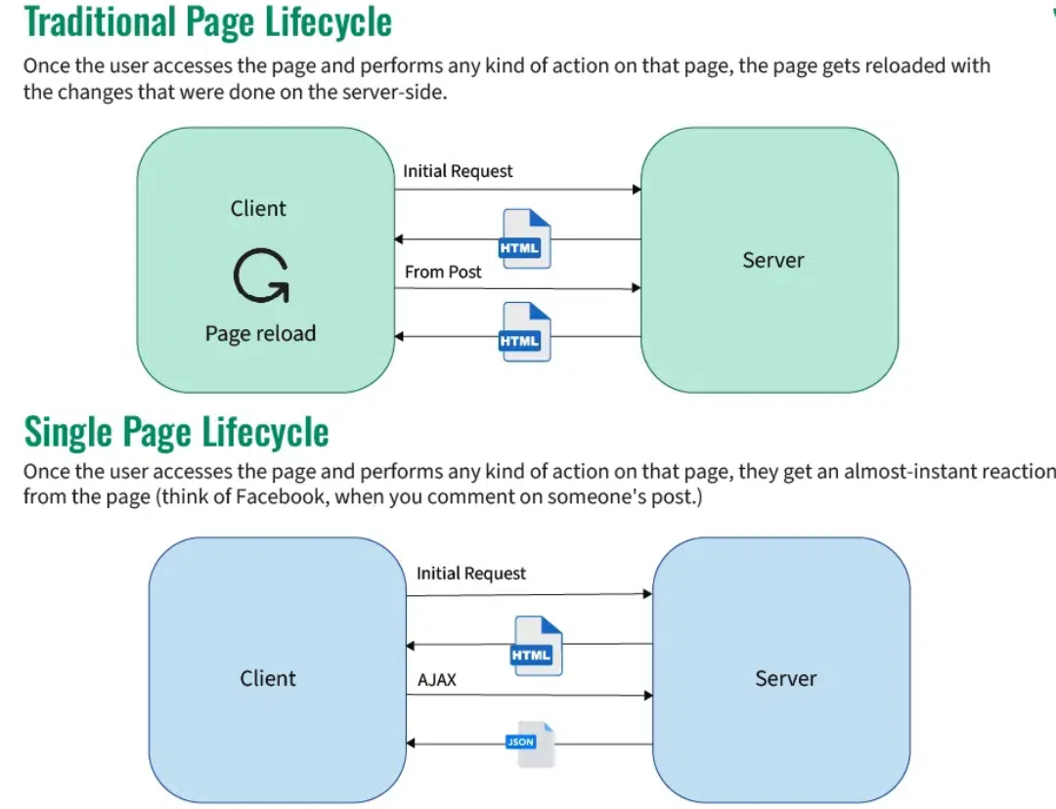
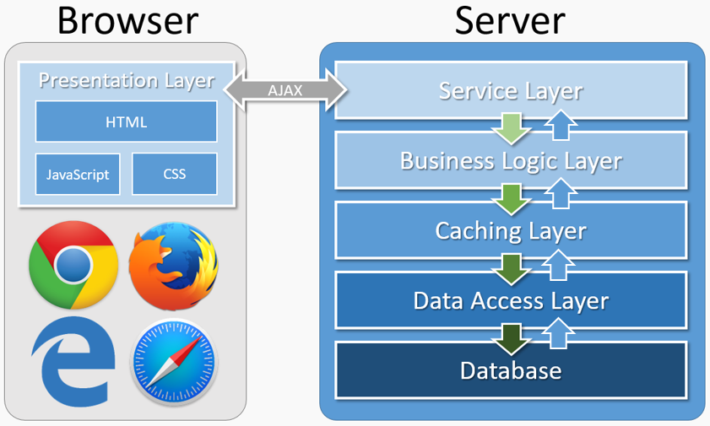
SPA Architecture - 1
Notes:
https://www.geeksforgeeks.org/what-is-single-page-application/

Slide 9
SPA Architecture - 2
Frontend (ReactJS):
Components: Reusable UI building blocks.
Virtual DOM: Efficiently updates the user interface.
JSX: JavaScript syntax extension for writing HTML-like structures.
State management: Libraries like Redux or Zustand for managing application state.
Backend (Spring Boot REST API):
RESTful endpoints: Provide data to the frontend in JSON format.
Spring MVC: Framework for building robust and scalable web applications.
Data Access: Spring Data JPA for interacting with databases.
Security: Spring Security for authentication and authorization.

Slide 10
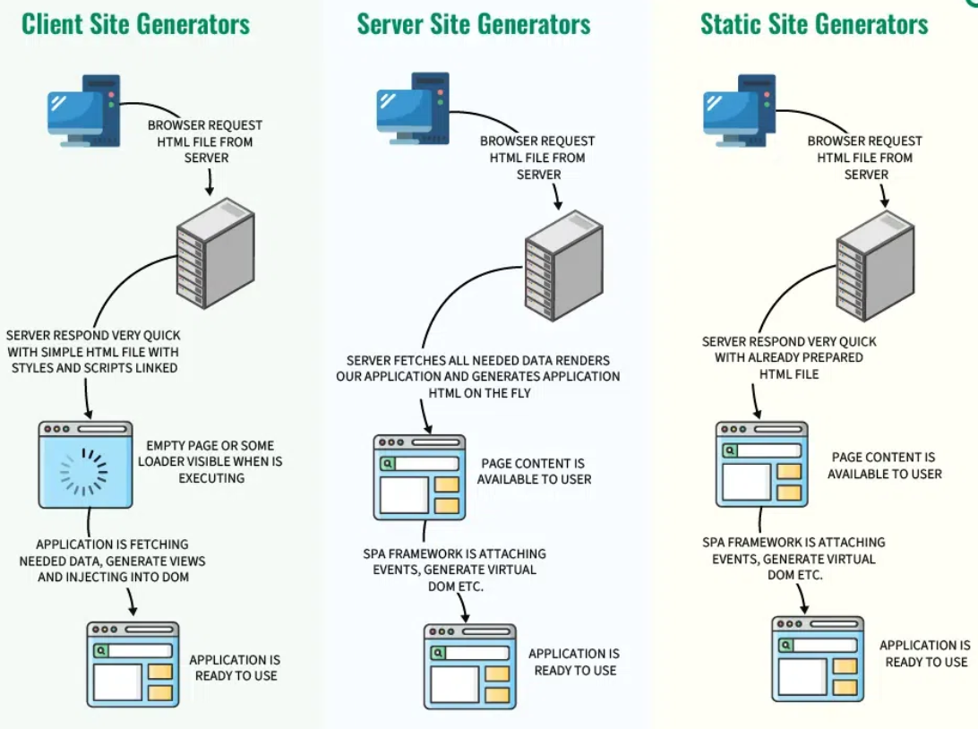
SPA Architecture and how does it work
Client-side rendering
First browser requests HTML from the server.
Then server swiftly responds with a basic HTML file and linked styles/scripts.
Now user sees a blank page or loader while JavaScript executes.
App fetches data, creates views, and injects them into the DOM.

Slide 11
SPA Architecture and how does it work
Server-side rendering (SSR)
The browser first asks the server for an HTML file.
Now server gathers necessary data, builds the SPA, and creates an HTML file instantly.
Now user sees the content ready to go.
Single-page app structure adds events, makes a virtual DOM, and gets things ready.
Now, the application is set for use.

Slide 12
SPA Architecture and how does it work
Static site generator (SSG)
Browsers ask for HTML, SSGs quickly provide pre-made static pages.
The server shows users the static page for fast loading.
SPAs in the page fetch data and make dynamic changes to the page.
SPA is ready for smooth user interaction after data is added.
SSGs are great for fast static pages but may not be ideal for highly dynamic websites.

Slide 13

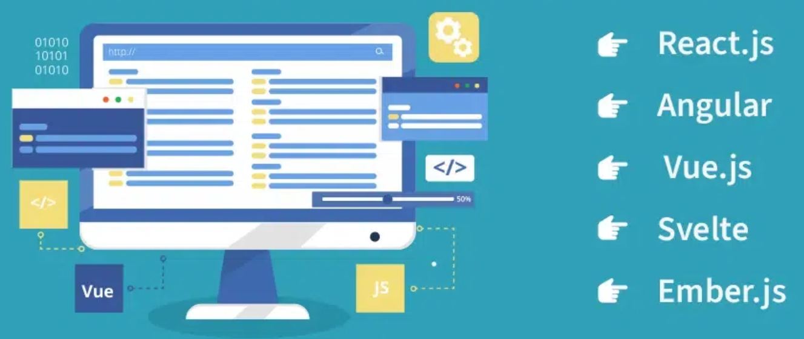





Popular framework for SPAs
https://react.dev/
https://angularjs.org/
https://vuejs.org/
https://svelte.dev/
https://emberjs.com/ https://backbonejs.org/
Notes:
https://www.geeksforgeeks.org/single-page-application-frameworks/

Slide 14
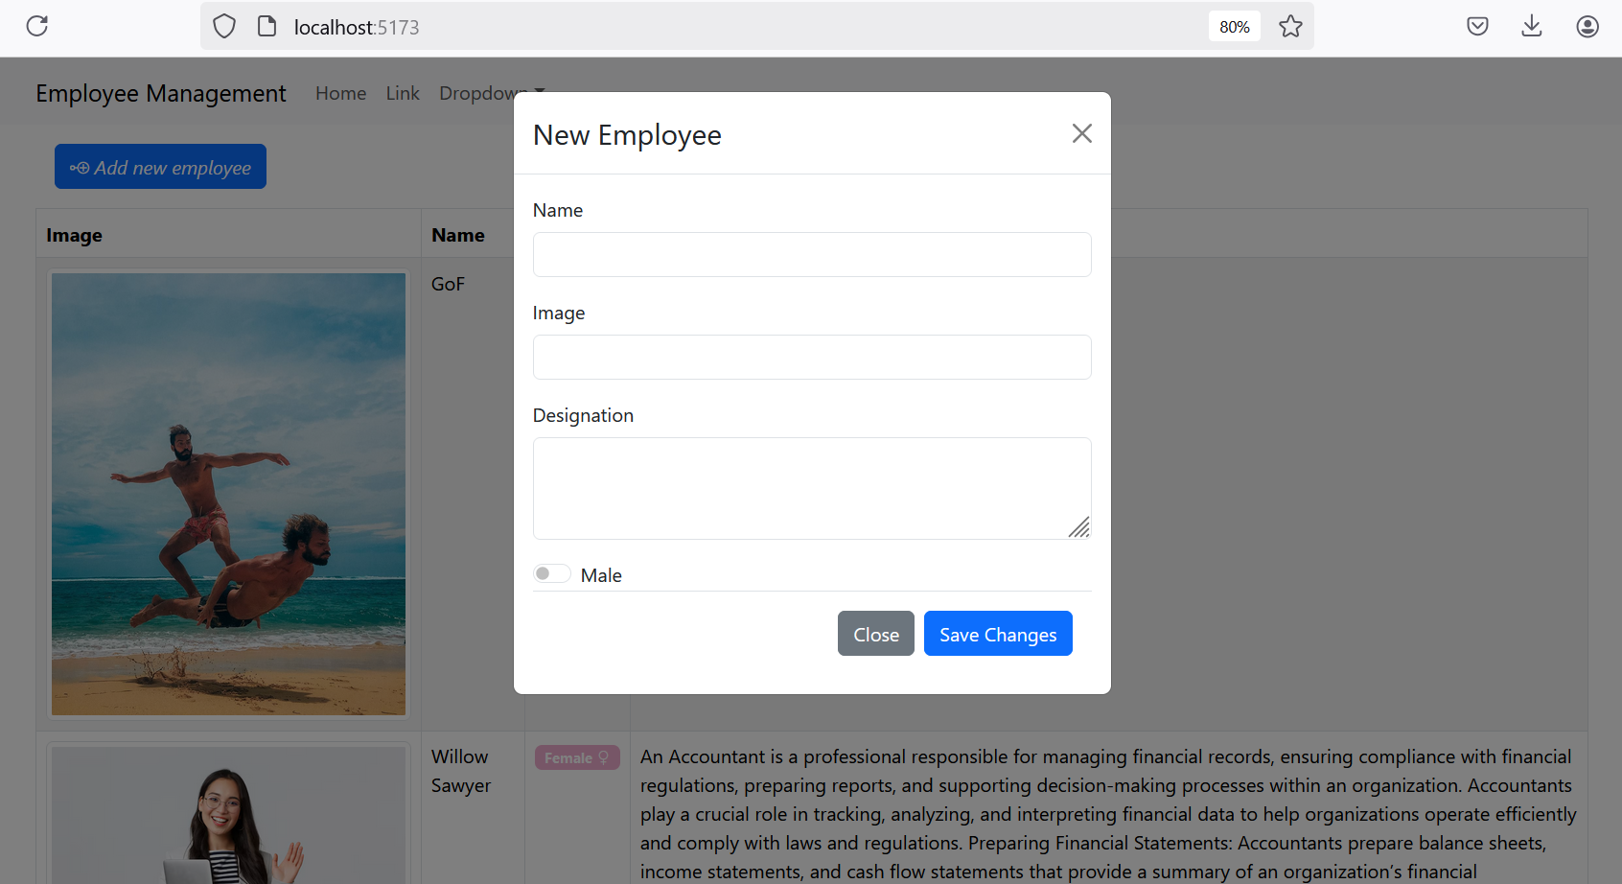
Demo - SPA with ReactJS and Spring Boot
Step 1. Create the Spring REST Backend (Chapter 11)
Step 2. Create the ReactJS Frontend

Slide 15
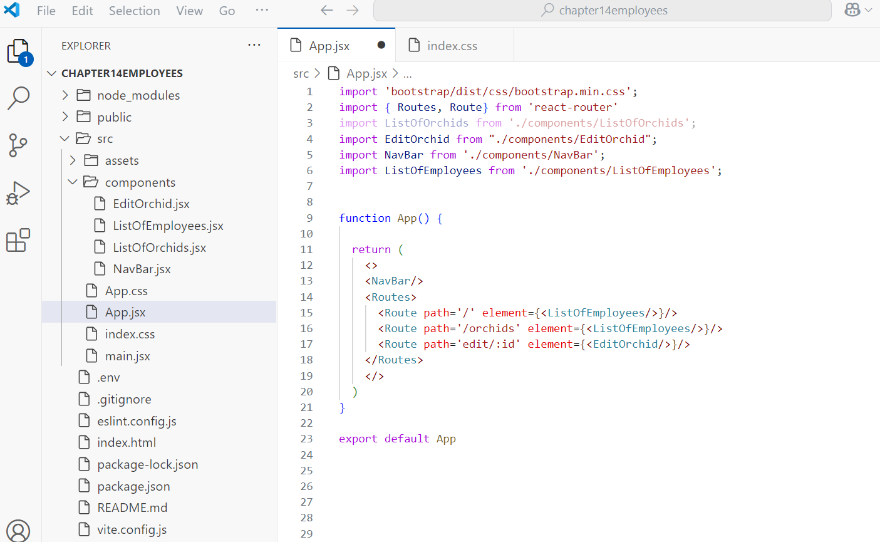
Demo - SPA with ReactJS and Spring Boot
Notes:
https://react-bootstrap.netlify.app/docs/getting-started/introduction

Slide 16
Summary
Concepts were introduced:
Single Page Application (SPA)
Advantages and disadvantages of SPA
SPA Architecture
Popular framework for SPAs
Implementation SPA with ReactJS and Spring Boot

